Slide 1

Tolkien would have been a great CISO
Building meaning through storytelling

Slide 2

Who am I
Chris Tyo (Tie-OH)
Director of Detection, Analysis, and Response @ Fifth Third Bank
Husband & Father of 2
EE from Ohio University, Math Minor
AV wannabe
Occassional disc golfer
Coffee

Slide 3
Who was JRR Tolkien
Author
Linguist
Professor
Influencer
Father
Veteran
Not actually a CISO

Slide 4
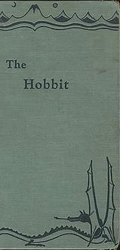
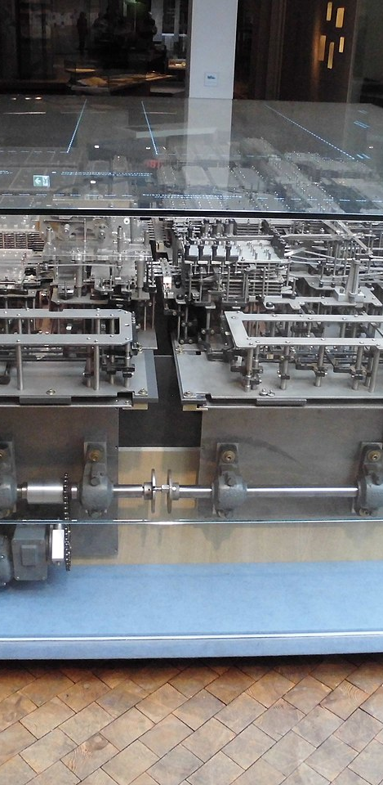
Hobbit 1937
Z1 was being built by Konrad Zuse. The Worlds first programmable computer. Weighed about 1 ton and had over 20k components.
Notes:
By Morn - Own work, CC BY-SA 3.0, https://commons.wikimedia.org/w/index.php?curid=48463774

Slide 5
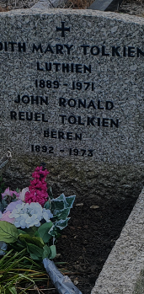
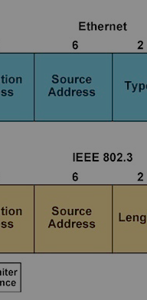
fin 1973
TCP and Ethernet invented in Palo Alto, CA by Robert Metcalfe and David Boggs
This Photo by Unknown Author is licensed under CC BY-SA

Slide 6
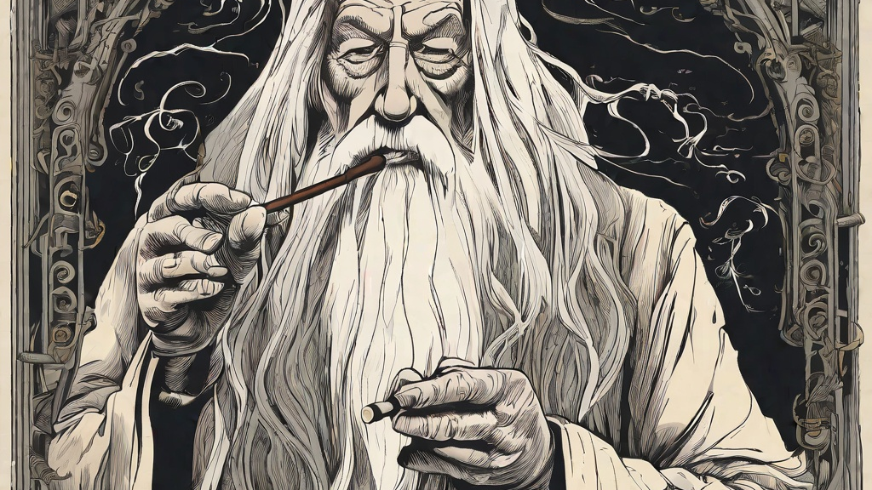
”Invention of a language is the foundation. The stories were made rather to provide a world for the languages than the reverse.
To me, a name comes first and the story follows.”

Slide 7
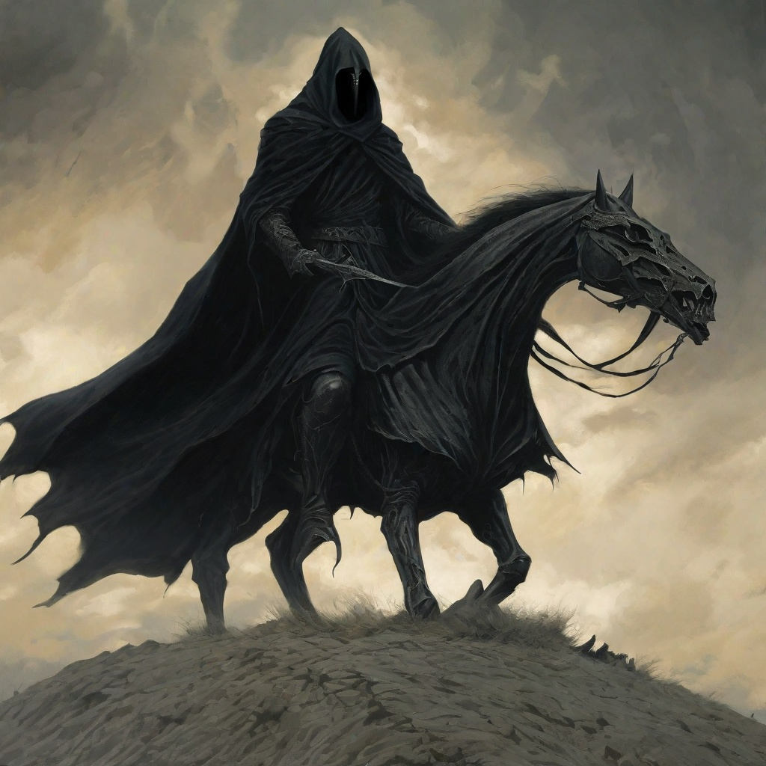
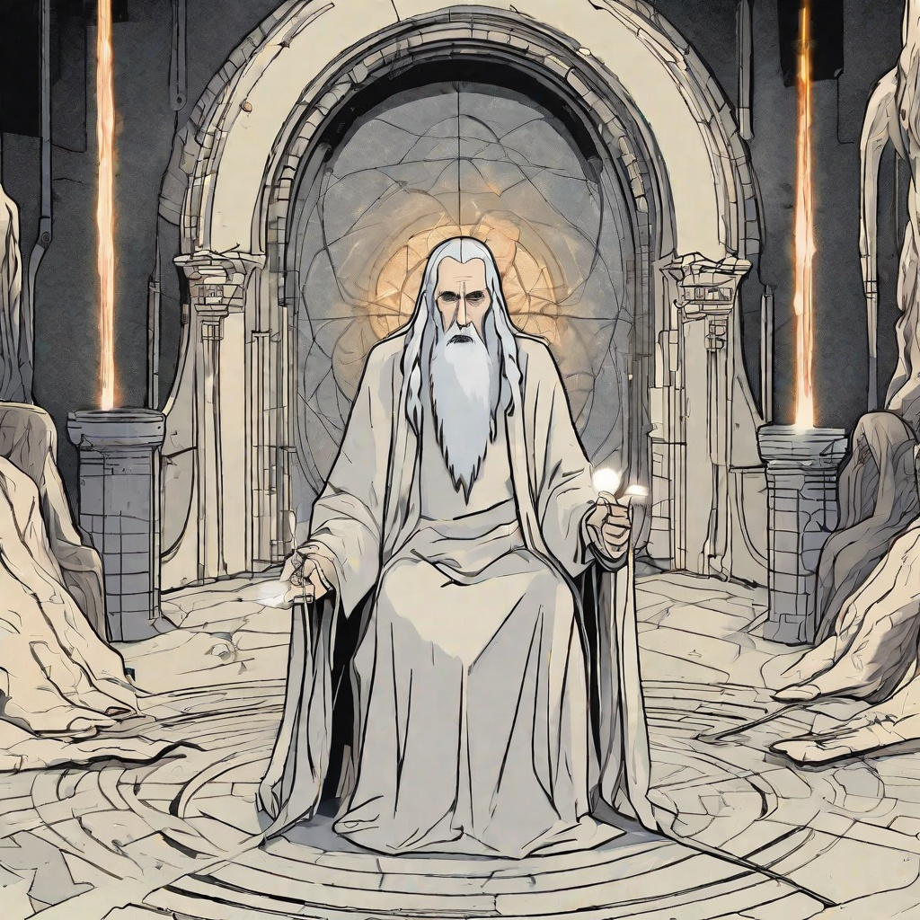
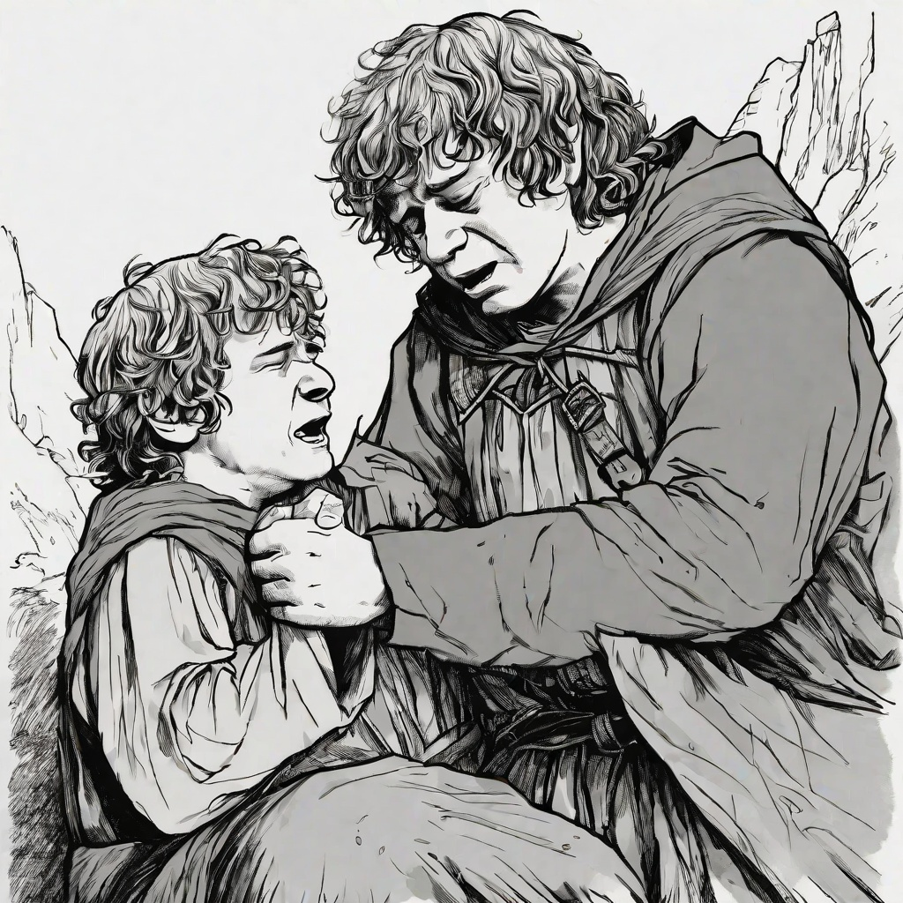
Tolkiens’s cyber stories
Ring Wraiths
Pierced by a Morgul blade
Throwing the ring in Mt. Doom
Shelob paralizing Frodo
Frodo and Sam’s entire relationship during Return of the King
The resource you go to to see what’s happened that then turns on you so much that you need to lock him in his tower and make sure nobody can interact with him

Slide 8
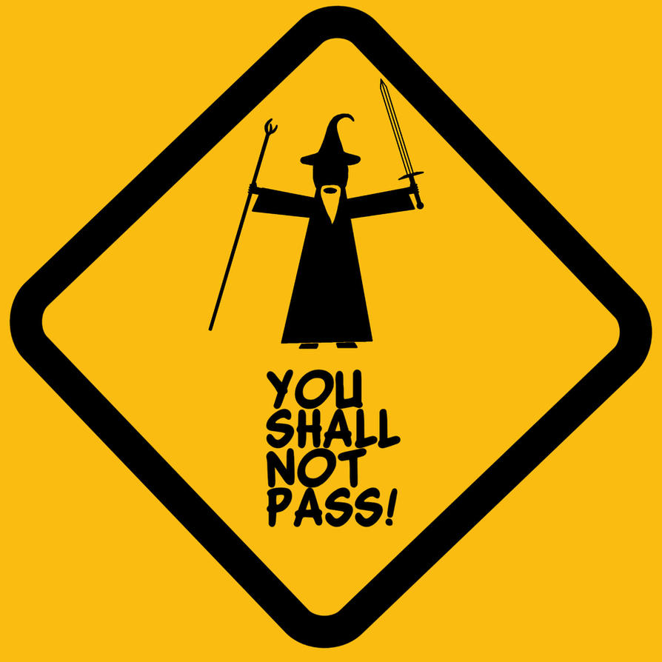

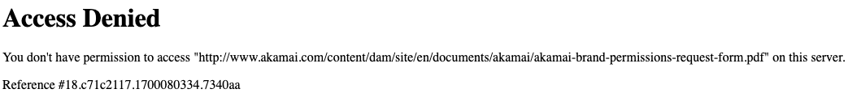
Notes:
This Photo by Unknown Author is licensed under CC BY-SA

Slide 9
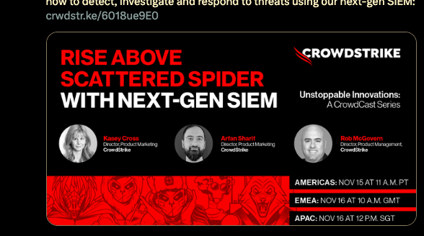

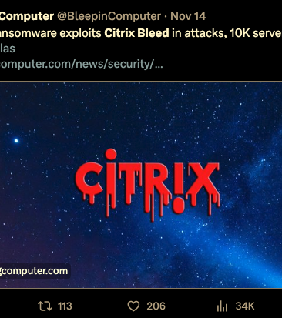
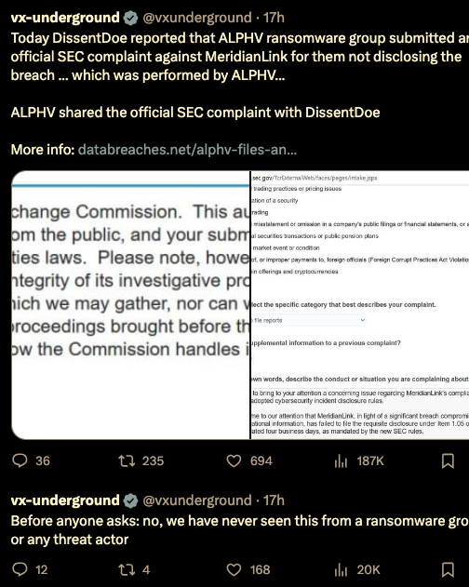
Who is writing your story?

Slide 10
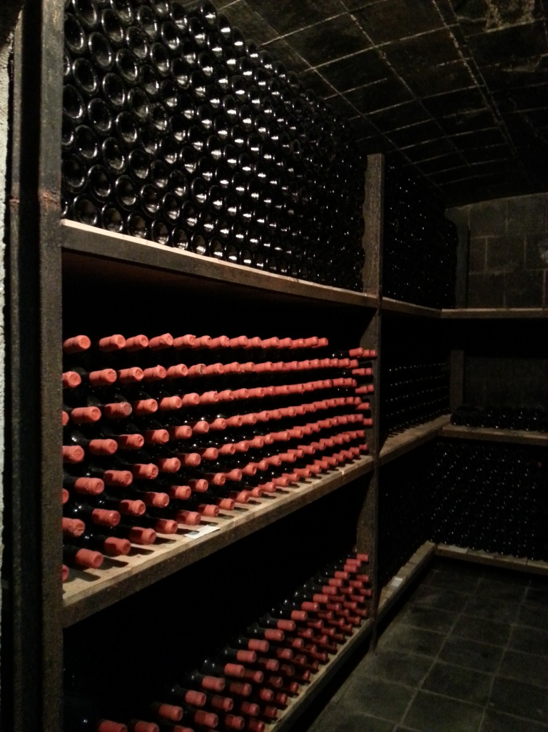
“… like discovering a complete wine cellar filled with bottles of amazing wine of a kind and flavor never tasted before. It quite intoxicated me.”
Notes:
This Photo by Unknown Author is licensed under CC BY-NC-ND

Slide 11

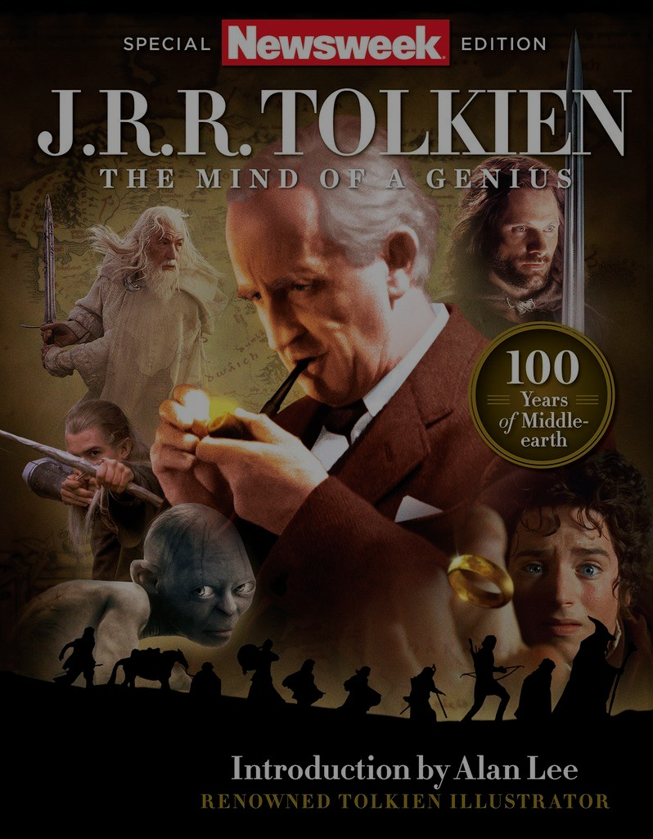
“(He) didn’t invent fantasy but he defined it in the minds of millions.”
Notes:
James Ellis, was excerpted from Newsweek's Special Edition: J.R.R. Tolkien—The Mind of a Genius

Slide 12
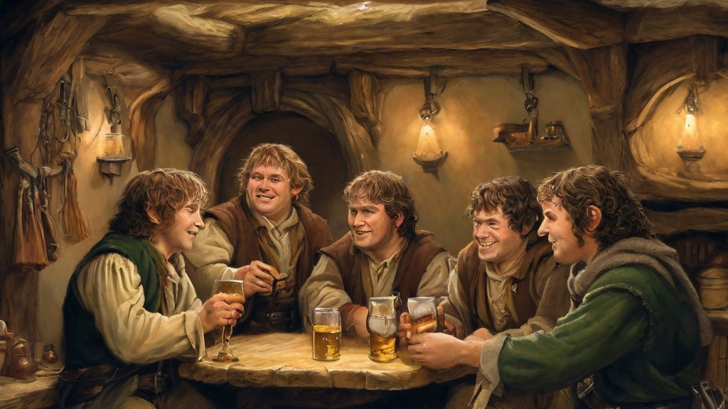
Many thanks

